Slide 1
Advanced Software Engineering Concepts
Software Reuse | Cloud Computing | AI in Software Engineering

Slide 2
What is Software Reuse?
📝 Concept:
✔ Software reuse is the practice of using existing software components to develop new applications, reducing development time and cost. ✔ Instead of building software from scratch, developers reuse code, frameworks, libraries, or complete applications.
✅ Benefits of Software Reuse: 🔹 Reduces Development Effort → Saves time & cost. 🔹 Improves Software Quality → Reused components are already tested. 🔹 Enhances Maintainability → Easier to update and fix issues.

Slide 3
Software Reuse: Application Frameworks
📝 Concept:
✔ Application frameworks provide a reusable set of tools, components, and libraries to speed up software development. ✔ They offer predefined structures for building applications.
✅ Types of Application Frameworks: 1️⃣ Web Frameworks → Django (Python), Spring Boot (Java) 2️⃣ Mobile Frameworks → Flutter, React Native 3️⃣ Enterprise Frameworks → .NET, J2EE.
💡 Example: 📌 Using Django for Web Development
Instead of writing database connections, authentication, and routing from scratch, Django provides built-in support.
✅ Best Practice: Use frameworks to speed up development and maintain consistency across applications.

Slide 4
Software Reuse: Software Product Lines (SPL)
📝 Concept:
✔ Software Product Line (SPL) is an approach where a set of related software products share a common architecture but have variations. ✔ SPL helps companies produce multiple software versions efficiently.
✅ Benefits of SPL: 🔹 Reduces Code Duplication → Common components are reused. 🔹 Faster Market Delivery → New versions are built quickly. 🔹 Customization → Different customers get tailored versions.
💡 Example: 📌 Microsoft Office Suite
Word, Excel, PowerPoint, Outlook share a common codebase, but each application has unique features.
✅ Best Practice: Use modular design & feature toggles to implement SPL effectively.

Slide 5
Software Reuse: COTS Product Reuse
📝 Concept:
✔ Commercial Off-The-Shelf (COTS) Product Reuse means using pre-built third-party software components instead of developing them in-house. ✔ COTS products are ready-made solutions that can be integrated into existing systems.
✅ Advantages of COTS Reuse: 🔹 Saves Time → No need to build from scratch. 🔹 Reduces Costs → Buying software is often cheaper than developing it. 🔹 Proven Reliability → COTS solutions are tested and widely used.
💡 Example: 📌 Using Google Maps API in Mobile Apps
Instead of building a custom mapping system, developers integrate Google Maps API into their apps.
✅ Best Practice: Use COTS when custom development is expensive or unnecessary.

Slide 6
What is Cloud-Based Software Engineering?
📝 Concept:
✔ Cloud-based software engineering focuses on developing, deploying, and managing software using cloud infrastructure instead of on-premises servers. ✔ It enables scalability, reliability, and cost savings.
✅ Key Features of Cloud Computing in Software Engineering: 🔹 Scalability → Applications can handle more users dynamically. 🔹 Cost-Effectiveness → Pay for only what you use. 🔹 Remote Collaboration → Teams can work from anywhere.
💡 Example: 📌 Netflix uses AWS Cloud
Stores and streams movies using Amazon Web Services (AWS), handling millions of users dynamically.
✅ Best Practice: Use cloud-based CI/CD pipelines for automated testing & deployments.

Slide 7
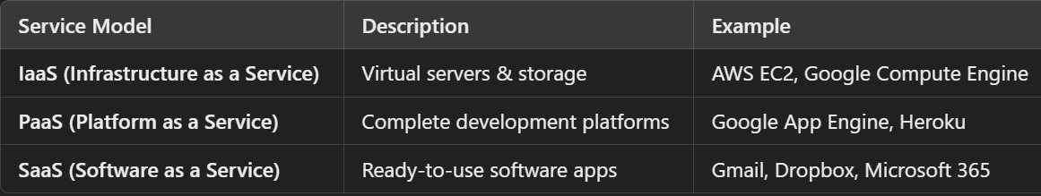
Types of Cloud Services in Software Engineering
✅ Cloud computing provides different service models:
✅ Best Practice: Use serverless computing (AWS Lambda, Azure Functions) for cost-efficient applications.

Slide 8
How AI is Transforming Software Engineering?
📝 Concept:
✔ AI-powered software engineering uses machine learning, automation, and intelligent systems to enhance development, testing, and deployment. ✔ AI helps in error detection, automated coding, and optimizing performance.
✅ Applications of AI in Software Engineering: 1️⃣ AI-Powered Code Generation → GitHub Copilot, OpenAI Codex. 2️⃣ Automated Testing → AI detects bugs & generates test cases. 3️⃣ AI-Based Project Management → Predicts delays & optimizes workflows. 4️⃣ Natural Language Processing (NLP) for Requirements Analysis → AI understands business requirements.
💡 Example: 📌 GitHub Copilot
Uses AI to suggest code snippets and autogenerate functions based on developer intent.
✅ Best Practice: Use AI-driven DevOps tools to automate software deployment & monitoring.

Slide 9
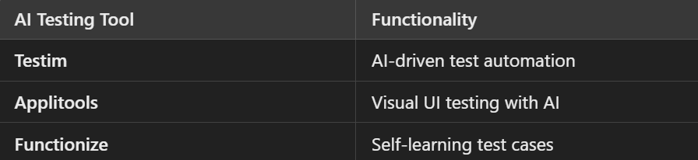
AI in Software Testing
✅ AI-powered testing tools improve software quality by detecting issues early.
💡 Example: 📌 AI-Powered Bug Detection
AI can scan thousands of lines of code to detect security vulnerabilities automatically.
✅ Best Practice: Use AI-enhanced test automation to improve efficiency.

Slide 10
Summary & Key Takeaways
Software reuse (Frameworks, Product Lines, COTS) speeds up development. ✔ Cloud-based software engineering enables scalability, cost savings, and remote collaboration. ✔ AI in software engineering automates coding, testing, and project management. ✔ Combining AI, Cloud, and Reuse creates faster, more efficient software development.

Slide 11
Old Question Practice
Given the data below:
Number of user inputs: 28
Number of user outputs: 44
Number of user inquiries: 7
Number of files: 3
Number of external interfaces: 2
And
Effort = 37 Person-Months
Technical document = 360 pages
User document = 129 pages
Cost = ₹8000 per month
Complexity adjustment values are: 4,1,1,3,5,5,4,4,3,3,3,2,3,4,5
Compute the following:
Function Point (FP) Value
Productivity
Documentation per Function Point
Cost per Function Point

Slide 12
Understanding Function Point Analysis (FPA)
Function Point Analysis (FPA) is used to estimate the size, effort, and cost of a software project. It consists of:
Unadjusted Function Points (UFP): Calculated from five components using standard weightings.
Complexity Adjustment Factor (CAF): Adjusts the UFP based on project complexity.
Adjusted Function Points (AFP): Final function point value incorporating complexity.
Productivity Calculation: Measures the number of function points produced per person-month.
Documentation Calculation: Determines how much documentation is produced per function point.
Cost per Function Point Calculation: Helps in budget estimation.

Slide 13
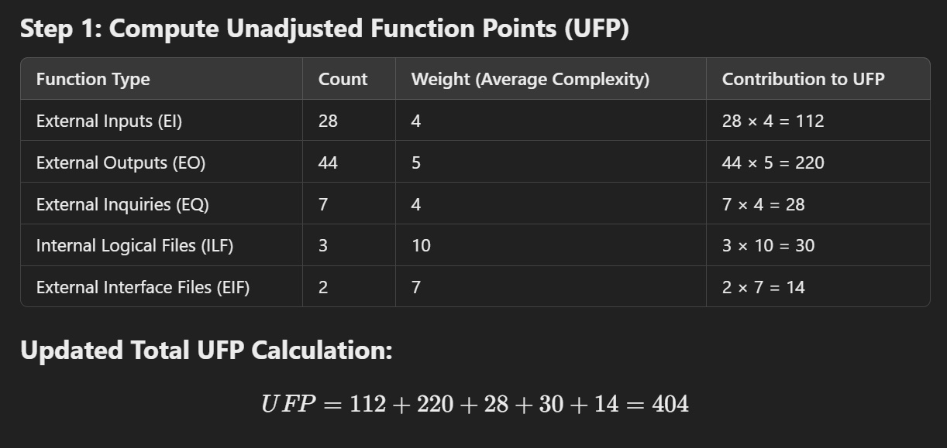

Slide 14
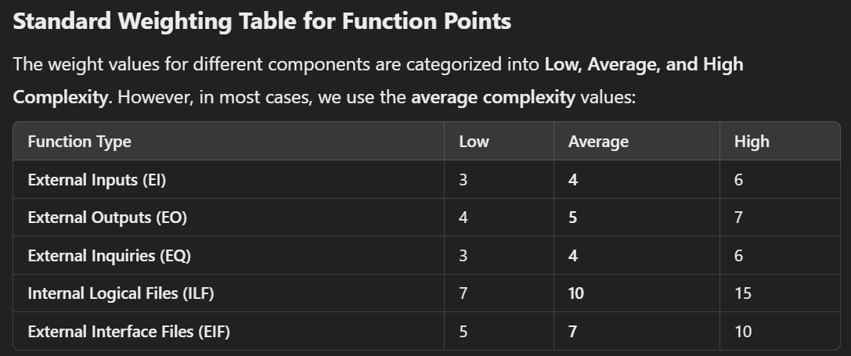

Slide 15
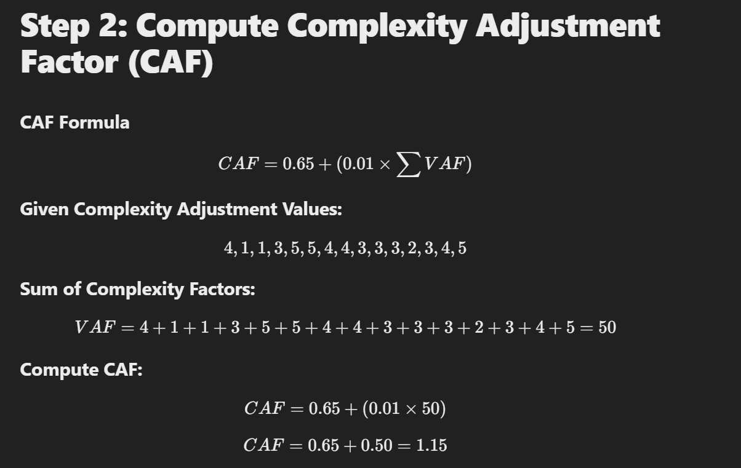

Slide 16
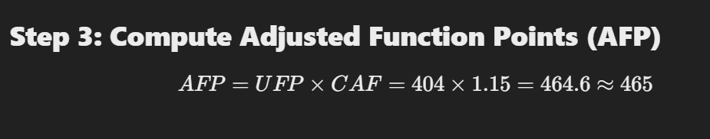
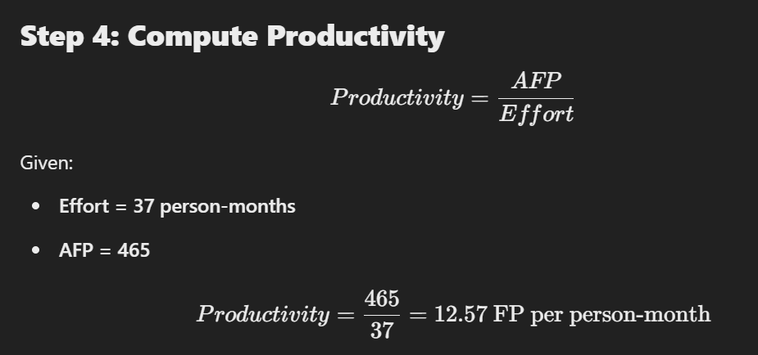

Slide 17
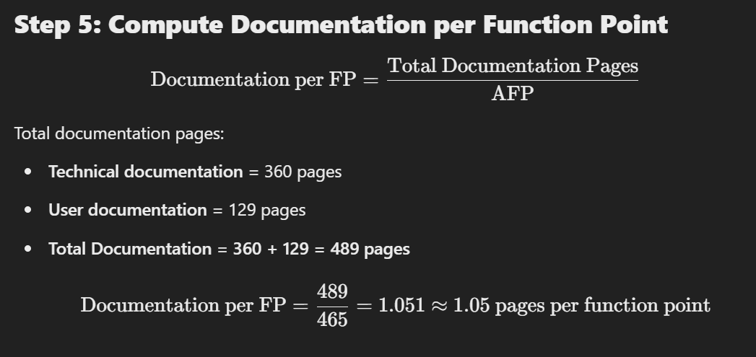

Slide 18
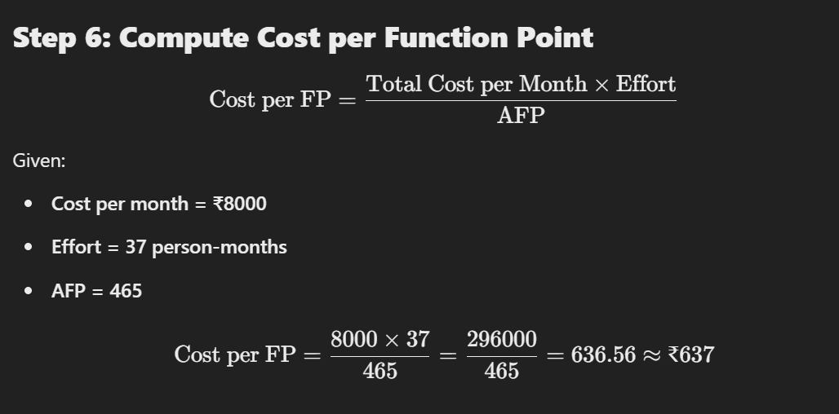

Slide 19
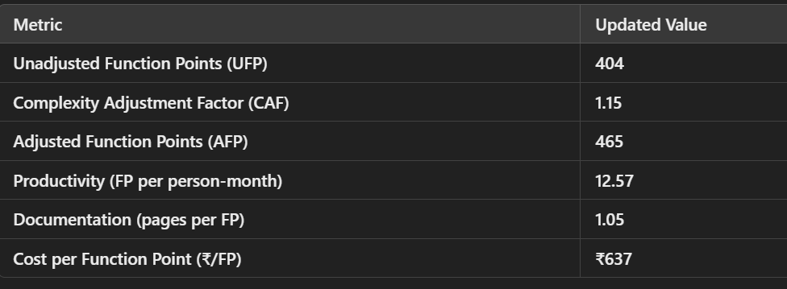

Slide 20
What is a Data Flow Diagram?
✔ A Data Flow Diagram (DFD) is a graphical representation that shows how data moves through a system. ✔ Helps in understanding system workflows, inputs, outputs, and data processing. ✔ Used for analyzing, designing, and documenting systems.

Slide 21
Why Use DFDs?
✅ Benefits of DFDs: 1️⃣ Helps visualize system processes → Easier to understand than text descriptions. 2️⃣ Identifies data sources, storage, and transformations → Clearly shows how data flows. 3️⃣ Improves system documentation → Useful for developers & stakeholders. 4️⃣ Detects inefficiencies & redundancies → Helps in system optimization.
💡 Example: 📌 Online Banking System
DFD can illustrate how users deposit, withdraw, or transfer money.
✅ Best Practice: Use DFDs to simplify complex system workflows!

Slide 22
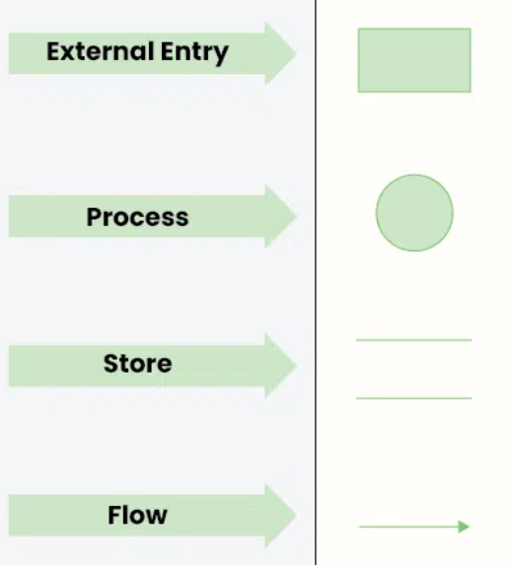
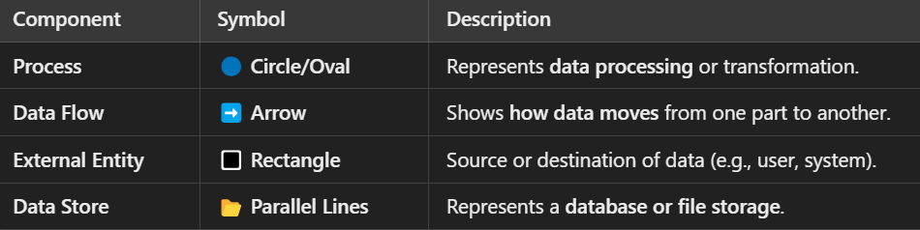
Components of a DFD
✅ A Data Flow Diagram consists of four key components:
✅ Best Practice: Follow DFD notation standards to make diagrams readable!

Slide 23
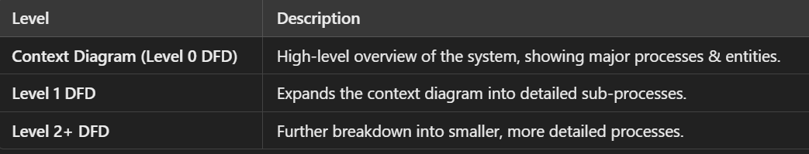
Levels of DFD
📌 DFDs are categorized into different levels based on detail:
💡 Example: 📌 E-commerce System
Level 0: Shows "Customer" placing an order in a system.
Level 1: Breaks down into "Order Processing," "Payment," and "Shipping."
Level 2: Further details each sub-process.
✅ Best Practice: Start with Level 0 (Context Diagram), then expand step by step!

Slide 24
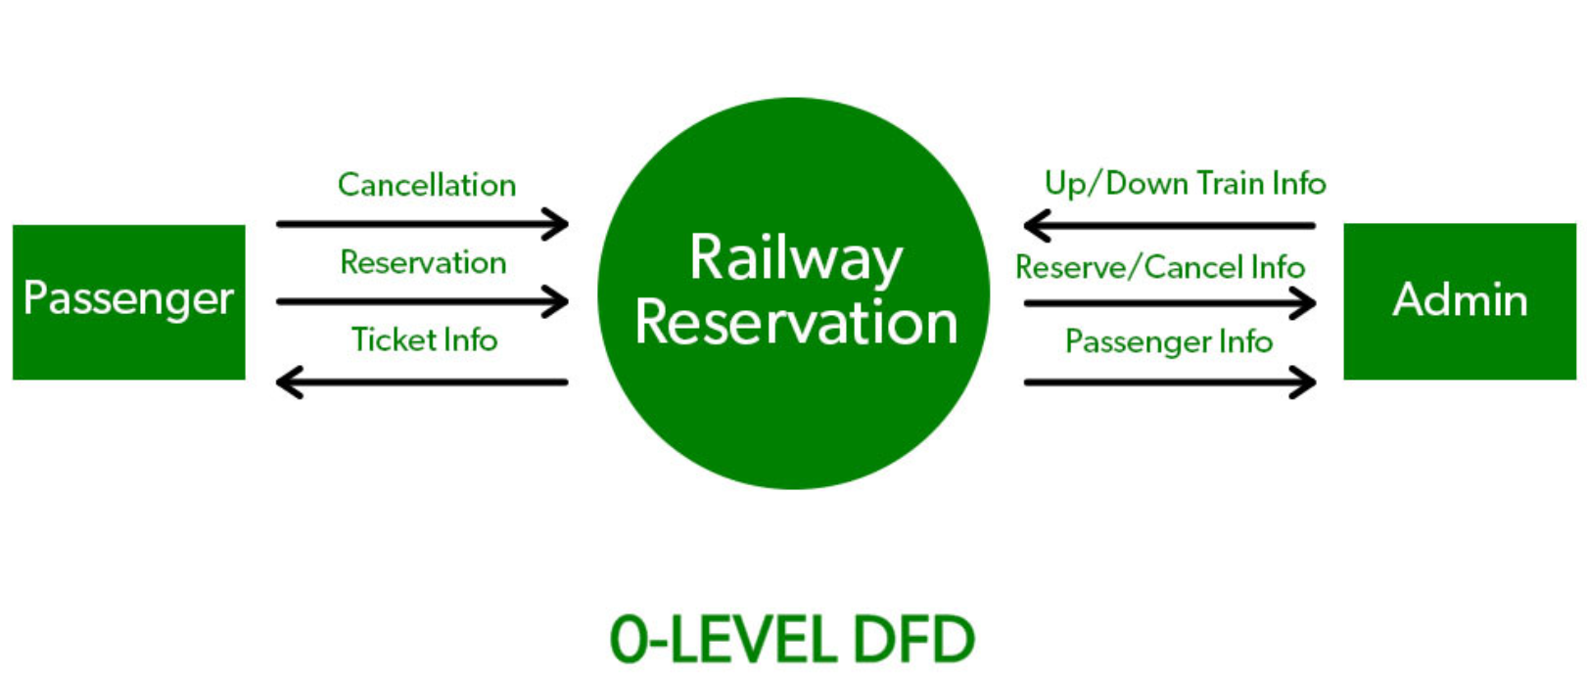
Example of DFD:

Slide 25
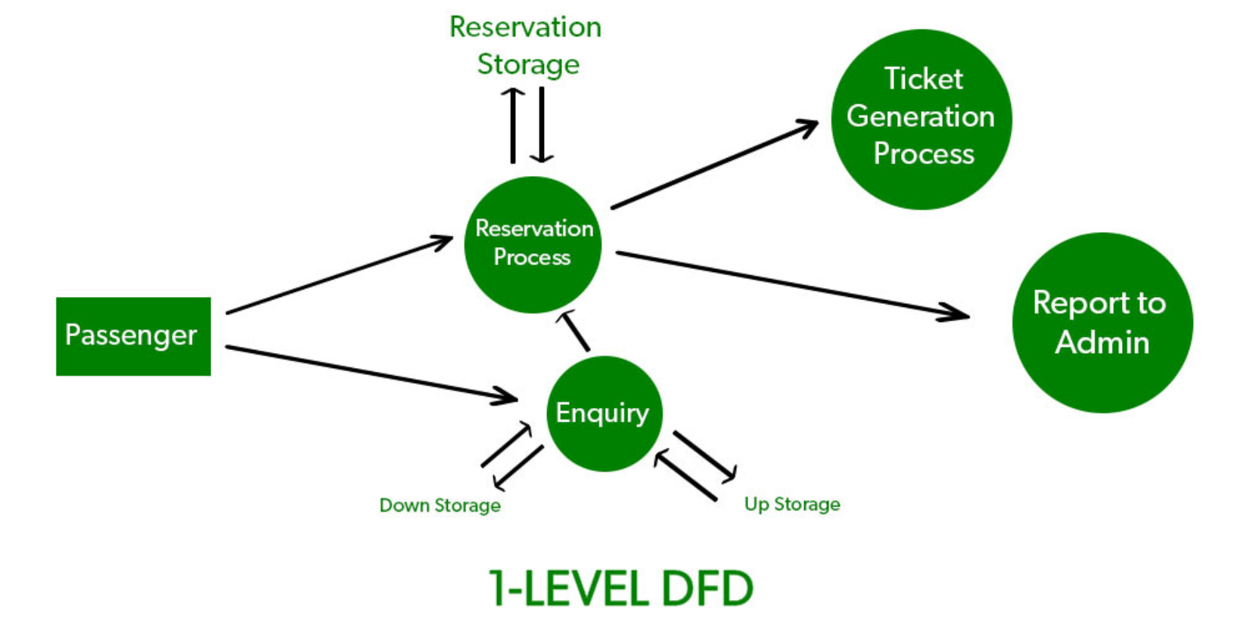
Example of DFD:

Slide 26
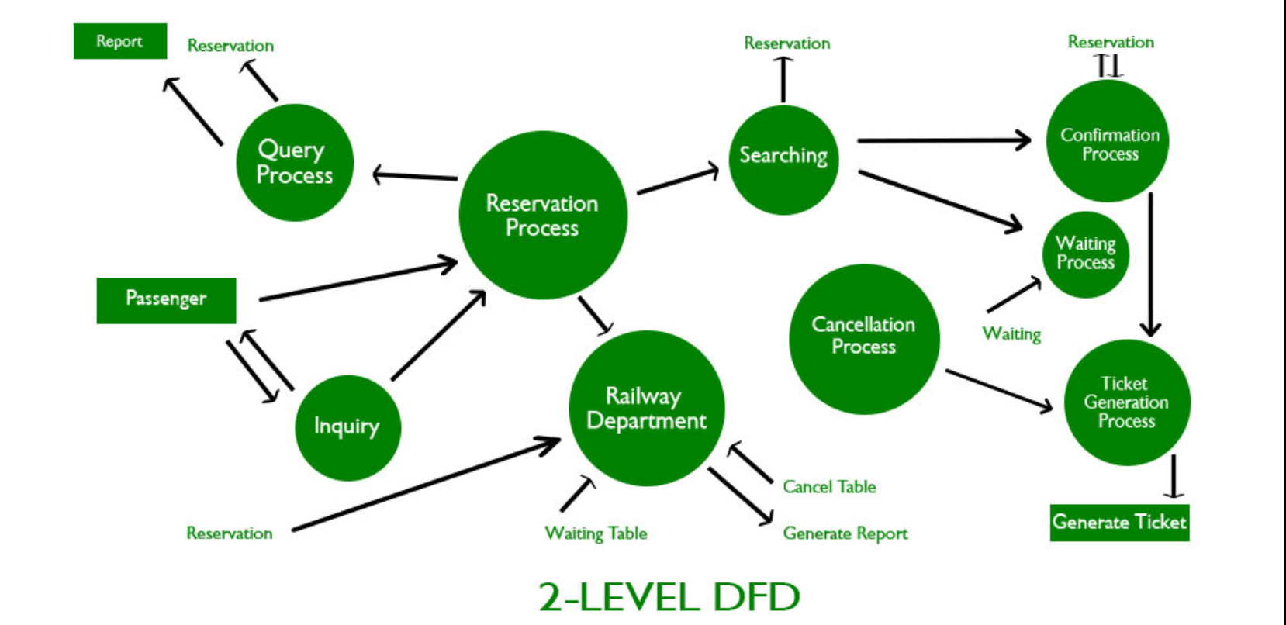
Example of DFD:

